Slide 1



Data Analysis
Lecture 6
Introduction to
Quantitative and Qualitative Analysis

Slide 2
Difference between Research Methodology and Research Methods
Methodology refers to the whole range of concepts and techniques like Philosophy, Approach, Design. Strategy, Data collection and other important decisions where as Research methods refer to only the Data collection, Analysis and Sampling .
Data collection methods – Interviews, focus groups , observation may give rise to generation of Qualitative Data in the Research, where as,
Surveys and many types of questionnaires generate number based or Quantitative data in the research.

Slide 3
Data analysis - Overview
An effective research design and a plan for the data collection will clearly indicate the instruments that will result in
a) Quantitative data and b) Qualitative data.
Therefore, when you plan the analysis, you need to think of the tools, techniques or approaches that you will use for he two types of data generated. We will look at both the categories of analyses.

Slide 4
Data Characteristics
Three types of quantitative data
Nominal – coding where order is not significant i.e age, gender, religion
Ordinal – qualitative scales i.e. very satisfactory, satisfactory, neither satisfactory nor unsatisfactory, unsatisfactory, very unsatisfactory
Interval – these data use a quantitative scale where the difference from one point to another is the same but the starting point is arbitrary.

Slide 5
Techniques for Quantitative analysis
Descriptive statistics – variables, frequencies, averages, ranges, pie charts
Inferential statistics – Assess significance of the results
Correlation between two variables – simple interrelationships and cross tabulations
Multivariate analysis – looking at relationships between more than two variables
Use of SPSS/ Excel software for Analysis

Slide 6
Descriptive Statistics
Central tendency
Mean – average value
Mode – the most frequently observed value
Median – the value which has as many scores above it as are below it.
Dispersion – how values are dispersed around the central measure
Inter-quartile range – the difference in the upper and lower limits within the middle 50 percent of the sample
Standard Deviation – measure the spread of values around the mean
Frequency distribution – counting the number of times a particular value occurs

Slide 7
Inferential Statistics
Significance – the probability of a relationship between two variables having occurred by chance
Students t-test
Chi Squared tests
Confidence intervals
Anova

Slide 8
Correlation Statistics
Correlation analysis – this calculates a coefficient that indicates the proportion of change in the dependent variable that is associated with changes in the independent variable.
Regression analysis – enables researchers to determine the nature of the relationship between the dependent and independent variable. It enables one to identify the line of correlation for a highly disparate set of data – the line of best fit.

Slide 9
Analysing Qualitative Data
Qualitative Data comes in the form of words
It is rich, many faceted
Takes the form of
Interview notes
Structured or unstructured observations from meetings
Diary entries
Documents from secondary data
Observations

Slide 10
Analysing Qualitative Data
The key is to look for
Patterns
Categories or types of information
To make sense of the data
Establish the real situation looked at from many perspectives

Slide 11
Analysing Qualitative Data
There are many different ways to analyse qualitative data
Given the tremendous variety in approaches, this lecture provides only an overview of the most commonly used in business and management, called Thematic analysis

Slide 12
Key approaches to Qualitative data analysis
Thematic analysis
Usually, what the researcher is trying to do is to identify, analyse and report patterns (themes) in the data

Slide 13
Thematic Analysis
Thematic analysis refers to the analysis of data through emerging themes.
Braun and Clark (2006, p. 79) define it as a method “…for identifying, analysing and reporting patterns (themes) within data”.
Similar to Grounded Theory it involves a three-stage process. The three stages are descriptive coding, interpretative coding, and defining overarching themes.

Slide 14
Preparing the data for thematic analysis
Key factors to be considered when collecting data
Transcribing interview results is very time consuming – A skilled touch typist takes 6-10 hours to transcribe 1 hour of recorded interview data
Categorise or codify the data
Review these categories regularly
Analyse your data whilst you collect it to find gaps and discrepancies enabling you to refine your research

Slide 15

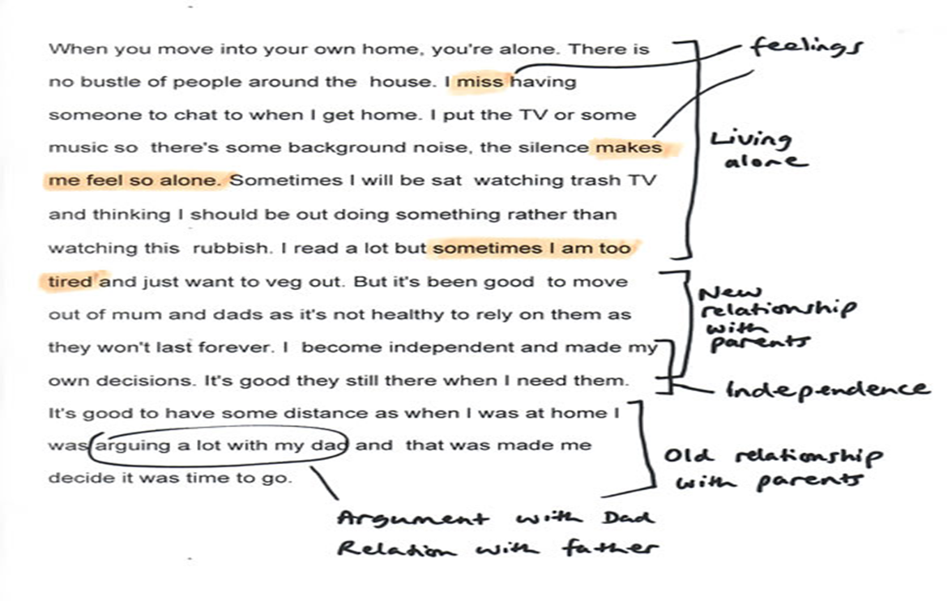

Coding Example
Expand this slide and read it!
Source: http://onlineqda.hud.ac.uk/Intro_QDA/phpechopage_titleOnlineQDA-Examples_QDA.php

Slide 16
Summary
The data analysis has to be planned along with the data collection
Quantitative analysis - involves analysing numeric data, where the variables and the tools and techniques need to be looked at carefully .
Qualitative analysis usually looks at text rich data where we do thematic analysis involving codes and categories.
Categories often change, so don’t be afraid to ‘uncode’, merge categories or split them into different ones.
Coding is only a means to an end, it should never become an end in itself in the qualitative analysis

